Slide 1
Chord: A Scalable Peer-to-peer Lookup Service for Internet Applications
Ion Stoica, Robert Morris, David Karger, M. Frans Kaashoek, Hari Balakrishnan MIT Laboratory for Computer Science
Presenters: Van Quach & Dale Pedzinski

Slide 2
Topics
Introduction
Related Work
System Model
Chord Protocol
Concurrent Operations and Failures
Simulation and Experimental Results
Future Work & Conclusion
Q & A
References

Slide 3
Introduction
What is Chord Protocol?
Consistent Hashing
Node maintains information about only O(log N) nodes
Resolves all lookups via O(log N) messages
Node joins/leave result in no more than O(log² N) messages
Main Features of Chord
Simplicity
Provable Correctness
Provable Performance
Funded by DARPA and the Space and Naval Warfare Systems Center (SPAWAR), San Diego, under contract N66001-00-1-893

Slide 4
Related Work
Key/Value Mappings
DNS hostname to IP address mapping
CAN
Lookup Operations
Freenet peer-to-peer storage system
Consistent Hashing
Ohaha system & Freenet-style query routing
Globe System
Distributed data location protocol
Oceanstore
Lookup Service
Napster

Slide 5
System Model
Core Features
Load Balancing
Decentralization
Scalability
Availability
Flexible naming
Applicable Applications
Cooperative Mirroring
Time-Shared Storage
Distributed Indexes
Large-Scale Combinatorial Search

Slide 6
Chord Protocol
“Chord Protocol defines how to find the location keys, how new nodes join the system, and how to recover from failure of existing nodes.”
What is included?
Consistent Hashing
Scalable Key Locations
Node Joins

Slide 7
Consistent Hashing
“THEOREM 1. For any set of N nodes and K keys, with high probability: 1. Each Node is Responsible for at most (1 + e) K/N keys 2. When an (N + 1)^{st} node joins or leaves the network, responsibility for O(K/N) keys changes hands (and only to or from the joining or leaving node). “
hash function assigns each node and key an m-bit identifier
Like SHA-1
node identifier is node’s hashed IP address
key’s identifier is produced by hashing the key 
Identifiers are ordered in an identifier circle modulo 2^{m} -1 
First node is successor(k) on the circle

Slide 8
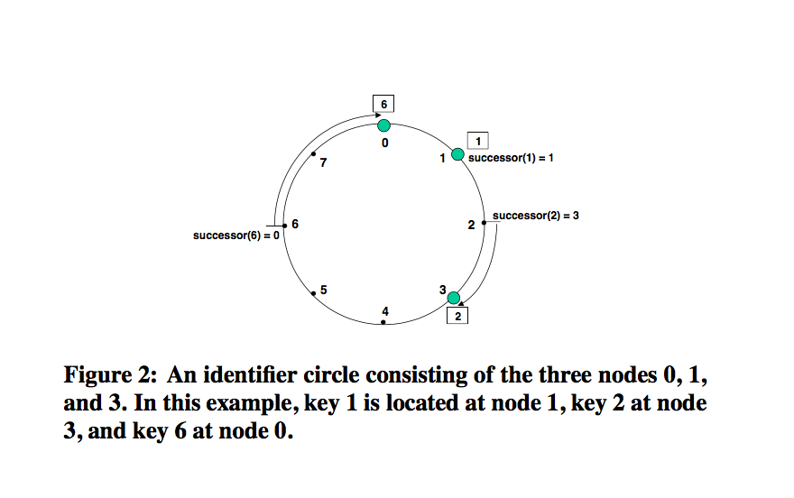
Consistent Hashing Terms
Key k is assigned to the first node with an identifier equal to or in the identifier space 
This node = successor node of key 
Node Joins the Network
Keys on n’s successor move
Node Leaves the Network
Keys move to successor

Slide 9
Scalable Key Locations
“THEOREM 2. With high probability (or under standard hardness assumptions), the number of nodes that must be contacted to find a successor in an N-node network is O(log N)”
A node only needs to know its successor node on the circle 
Queries utilize these successor nodes by finding the first node that succeeds the requested identifier 
It is possible to traverse all N nodes

Slide 10
Scalable Key Locations Terms
m=> number of bits in the key/node identifiers 
finger table=> each node maintains a routing table with, at most, m entries (includes the Chord identifier and the IP address of the relevant node)
A node’s finger table generally does not contain enough information to determine the successor of a key
successor => first entry of node n’s finger table, or the next node on the identifier circle
predecessor => previous node on the identifier circle
i^{th} finger => The ith entry of node n’s finger table contains the identity of the first node, s, that succeeds n by at least 2^{i-1} on the identifier circle, i.e., s=successor(n + 2i-1), where 1 ≤ i ≤m and all arithmetic is modulo 2 m

Slide 11
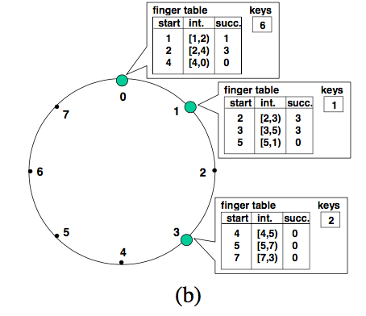
Search Process
find _successor: finds immediate predecessor node of identifier
Find_predecessor: moves forward around the Chord circle towards id
Number of forwards necessary for search: O(log N)
Average lookup time is 1/2 log N

Slide 12
Node Joins
“THEOREM 3. With high probability, any node joining or leaving an N-node Chord network will use O(log² N) messages to re-establish the Chord routing invariants and finger tables. “
Chord preserves two invariants:
node’s successor is correctly maintained
For every key k, node successor(k) is responsible for k
(In order for lookups to be fast, it is also desirable for the finger tables to be correct)
Each node in Chord maintains a predecessor pointer
contains the Chord identifier and IP address of the immediate predecessor of that node

Slide 13
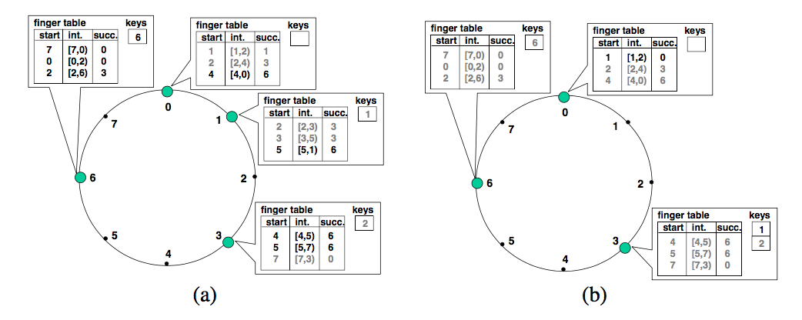
Node Joins
Chord must perform three tasks when a node joins the network: 
Initialize the fingers and predecessor of node n
Update the fingers and predecessors of existing nodes to reflect the addition of n
Notify the higher layer software so that it can transfer state (e.g. values) associated with keys that node n is now responsible for

Slide 14
Initialize the fingers and predecessor of node n
Node n learns its predecessors by asking n’ to look them up
O(m log N)
Number of finger entries looked up via utilizing a check on ith finger entry: O(log N)
Overall time: O(log² N)
Optimization: a newly joined node n can ask immediate neighbor for a copy of its finger table and it’s predecessor
Reduces overall time to O(log N)

Slide 15
Update the fingers and predecessors
Node n will need to be entered into the finger tables of some existing nodes 
Node n will become the ith finger of node p iff
p precedes n by at least 2^{i-1} 
The i^{th} finger on node p succeeds n
Find predecessor p of node n
Check if table needs updates
Repeat for predecessor of i
Number of nodes that need an update: O(log n)
Overall time it takes: O(log² N)

Slide 16
Transfer State
Move data, associated with each key, over to new node
Node n only needs to contact one node to transfer keys to it

Slide 17
Dynamic Operations and Failures
Practical issues:
Nodes join system concurrently
Nodes fail or leave voluntarily
Notes:
In practice Chord needs to deal with nodes joining the system concurrently and with nodes that fail or leave voluntarily. In order to guarantee correctness of lookups, Chrod need a “stabilization” protocol to keep nodes’ successor pointers up to date. Those successor pointers are then used to verify and correct finger table entries, which allows these lookups to be fast as well as correct.

Slide 18
Stabilization protocol
Main Goal: Keep nodes’ successor pointers up to date
Stabilization scheme:
join()
stabilize()
notify()
fix_fingers()
Notes:
Chrod’s author introduce stabilization protocol with 4 main methods:

Slide 19
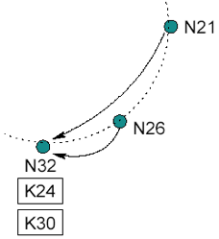
join()
Asks m to find the immediate successor of n.
Doesn’t make rest of the network aware of n.
n.join(m)
predecessor = nil;
successor = m.find_successor(n);
Notes:
When node first starts, it calls join , where is any known Chord node. The function asks to find the immediate successor of m. By itself, does not make the rest of the network aware of n

Slide 20
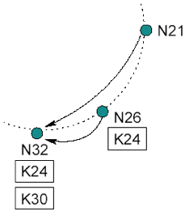
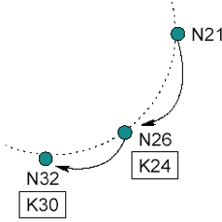
stabilize()
Called periodically to learn about new nodes
Asks n’s immediate successor about successor’s predecessor p
Checks whether p should be n’s successor instead
Also notifies n’s successor about n’s existence, so that successor may change its predecessor to n, if necessary
n.stabilize()
x = successor.predecessor;
if (x ∊ (n, successor))
successor = x;
successor.notify(n);
Notes:
Every node runs stabilize periodically (this is how newly joined nodes are noticed by the network). When node runs stabilize, it asks ’s successor for the successor’s predecessor , and decides whether should be ’s successor instead. This would be the case if node recently joined the system. stabilize also noti- fies node ’s successor of ’s existence, giving the successor the chance to change its predecessor to . The successor does this only if it knows of no closer predecessor than m.

Slide 21
notify()
m thinks it might be n’s predecessor
n.notify(m)
if (predecessor is nil or m ∊ (predecessor, n))
predecessor = m;

Slide 22
fix_fingers()
Periodically called to make sure that finger table entries are correct
New nodes initialize their finger tables
Existing nodes incorporate new nodes into their finger tables
n.fix_fingers()
next = next + 1 ;
if (next > m)
next = 1 ;
finger[next] = find_successor(n + 2^{next-1});

Slide 23
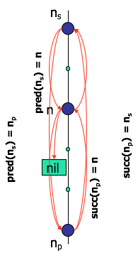
Stabilization after join
n joins
predecessor = nil
n acquires n_{s} as successor
n notifies n_{s} being the new predecessor
n_{s} acquires n as its predecessor
n_{p} runs stabilize
n_{p} asks n_{s} for its predecessor (now n)
n_{p} acquires n as its successor
n_{p} notifies n
n will acquire n_{p} as its predecessor
all predecessor and successor pointers are now correct
fingers still need to be fixed, but old fingers will still work
1d
1b,c
2a, b
1a
2c, d

Slide 24
Lookups before stabilization finish
Three behaviors can occur before Chord ring stable:
All finger table entries are reasonably current ⇒ take O(logN) steps
Successor pointers are correct, but fingers inaccurate ⇒ correct lookups, but slower
Incorrect successor, or keys not yet migrated to newly joined nodes ⇒ lookups may fail, can pause and retry.
Notes:
Although Chrod’s stabilization process doesn’t takes much time, but there is a chance that chrod’s ring receive lookups request before stabilization process finish.

Slide 25
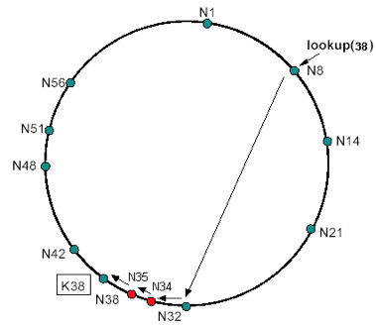
Failure Recovery
Main goal: maintain correct successor pointers
How:
Each node maintains a successor list of r nearest successors on the ring
If node n notices its successor has failed, it replaces the failed node with the 1st live entry
stabilize will correct finger table entries and successor-list entries pointing to failed node

Slide 26
Voluntary Node Departures
Can be treated as node failures with enhancements
Transfer all keys to its successor
Notify its predecessor and successor

Slide 27
Chord - Fact
Every node is responsible for about K/N keys
When a node joins or leaves an N-node network, only O(K/N) keys change hands (and only to and from joining or leaving node)
Lookups need O(logN) messages
Stabilization for node leaving / joining need O(log²N) message

Slide 28
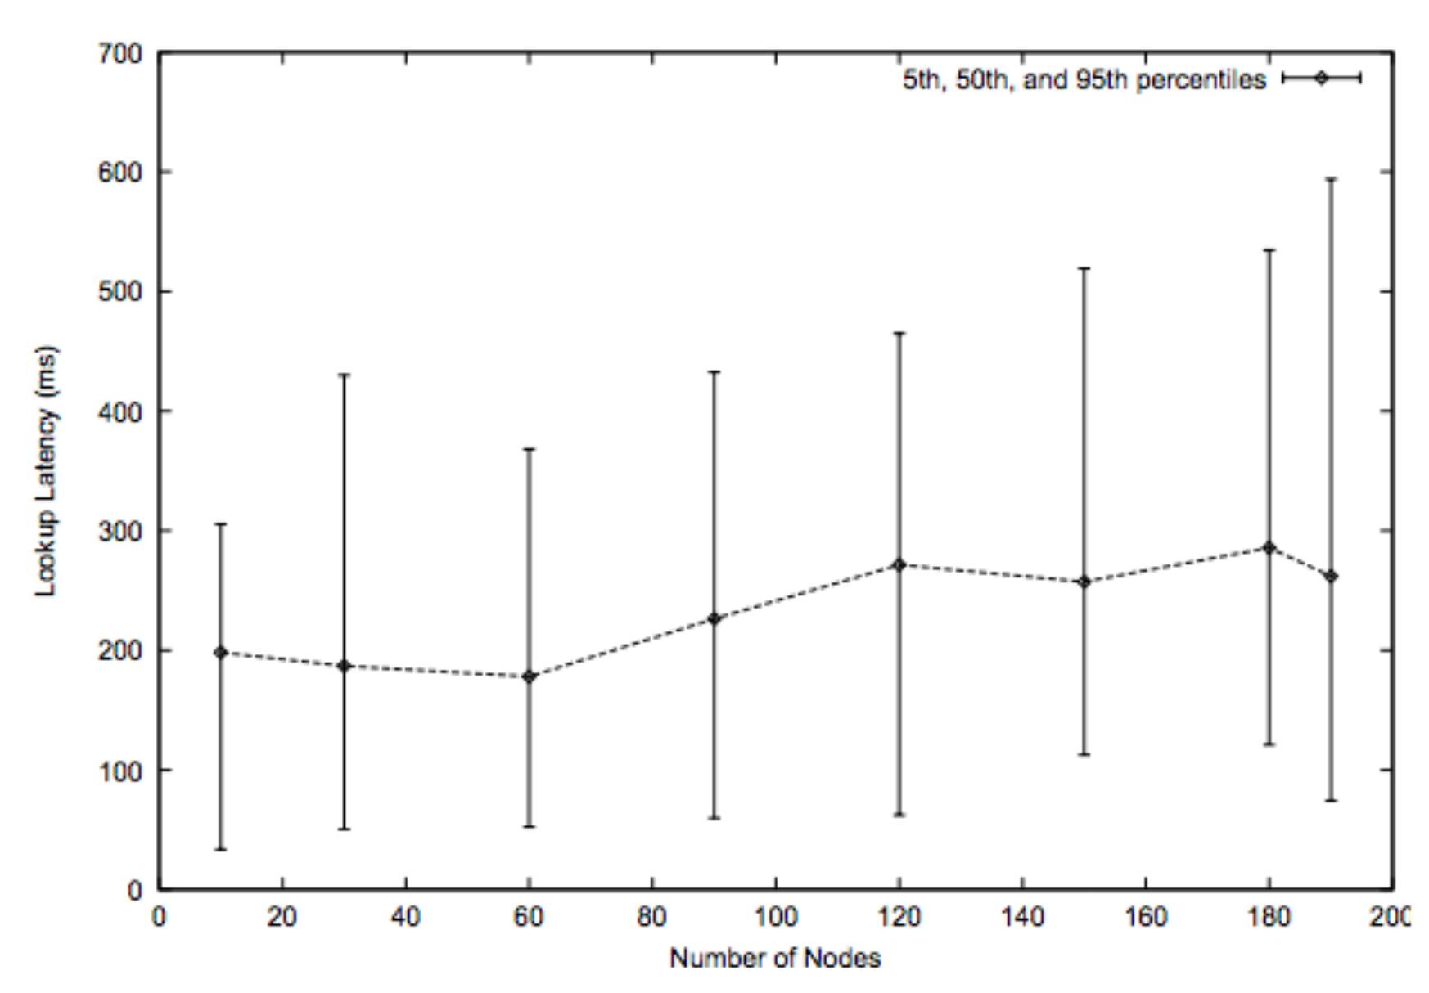
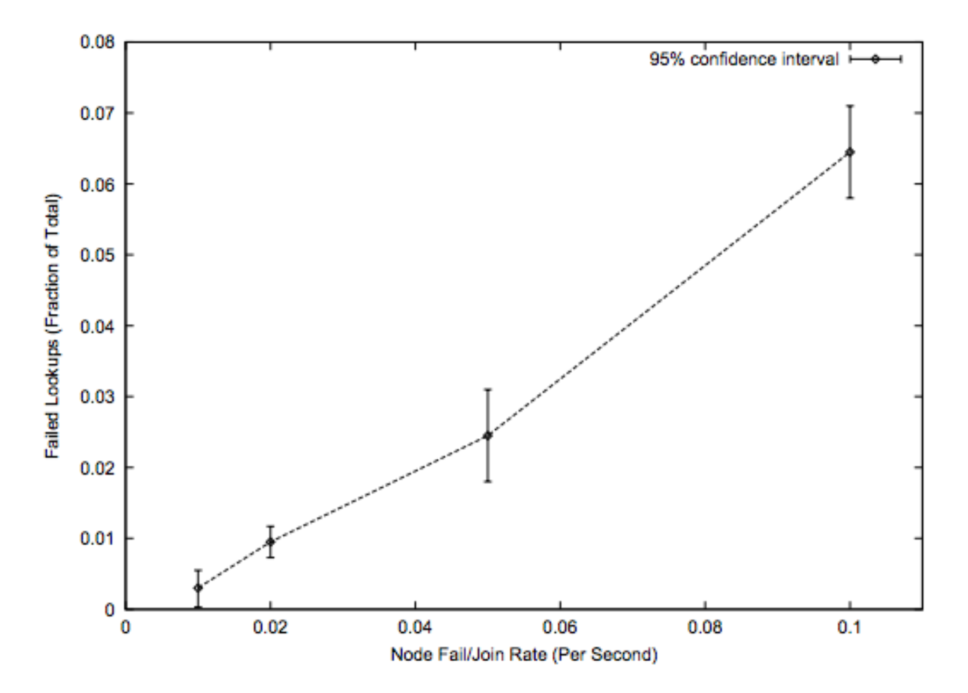
Experimental Results
Latency grows slowly with total number of nodes
Chord is robust for multiple node failures

Slide 29
Q & A

Slide 30
References
https://pdos.csail.mit.edu/papers/chord:sigcomm01/chord_sigcomm.pdf

